Slide 1
Chef
Brandon Martin
Career Field Experience
5th Hour

Slide 2
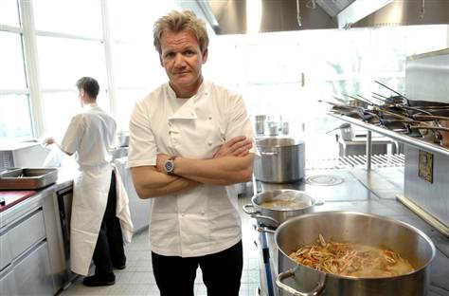
Introduction
Careers are something only those with true passion and integrity should pursue as Johann Wolfgang von Goethe said; Our passions are the true phoenixes; when the old one is burnt out, a new one rises from its ashes.
I feel as if the quote above displays my experiences throughout the year. The first time I experimented with an IT Technician and then moved on to a position in a restaurant as a cook.
There were a couple of features that got me into wanting to become a chef. One of them being my mother because she cooks amazing food, I don’t think i’ve ever had anything that she made I didn’t like. Also, I always loved watching cooking shows and wondering if I could ever cook as good as the hosts or if maybe one day I would be part of a cooking show in the future.

Slide 3
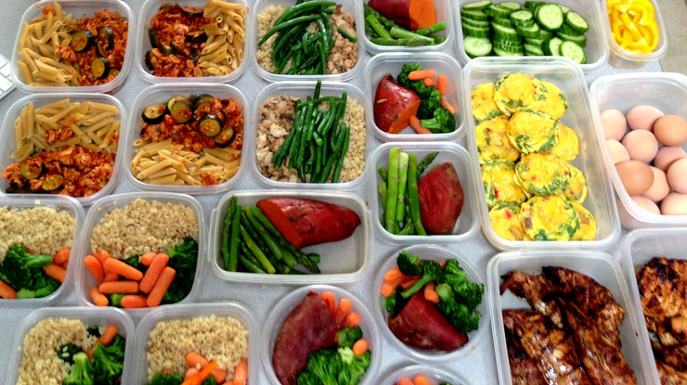
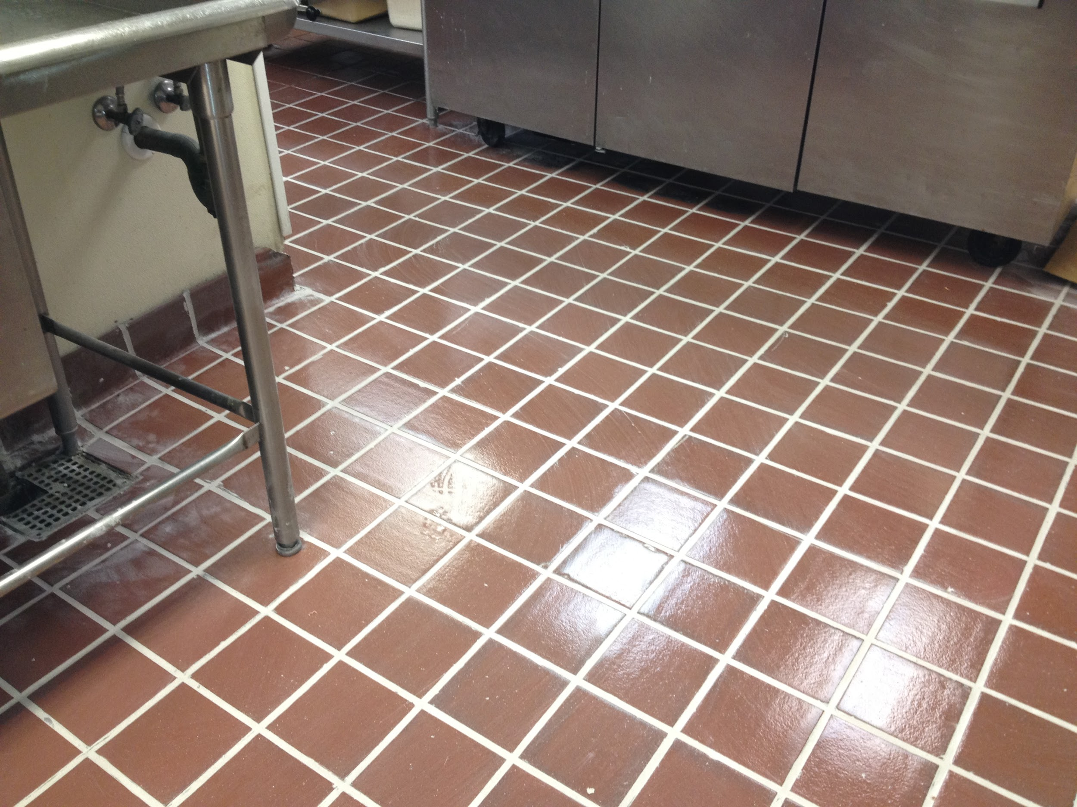
Responsibilities
Keeping everything clean
Making sure the temperature of food is proper
Prepare ahead of time
Stay focused
Respect Co-workers

Slide 4
How-to Use A Knife Properly
Step 1: Tuck thumb in of hand opposite of the one wielding the knife
Step 2: Curl 4 fingers over thumb
Step 3: Align hand perpendicular of the knife
Step 4: Place knife down on cutting board and make sure it stays there
Step 5: Carefully slide down what you are cutting while slicing and stay in formation

Slide 5
Training, Qualifications, and Education
Education: Not required but recommended
My Education: Macomb Culinary Program
Classes: Culinary Classes
Employer recommended classes: Culinary Classes

Slide 6
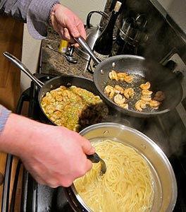
Quote from Employer
“Learn how to do multiple tasks at a time and you will be able to do anything as a successful chef.” ~Pam Maggio

Slide 7
Quote from Letter of Recommendation
“ I would also like to mention he is very punctual and gets the job done with little questions asked and shows signs that he really does love to cook and prepare dishes.” ~Pam Maggio
I realized this the minute I pursued this occupation
I liked the fact that it was stated from someone other than me

Slide 8
Evaluations
One thing to work on: Completing tasks with little questions asked
Why?: Individual work can be beneficial
How so?: Completing a task by yourself is more rewarding

Slide 9
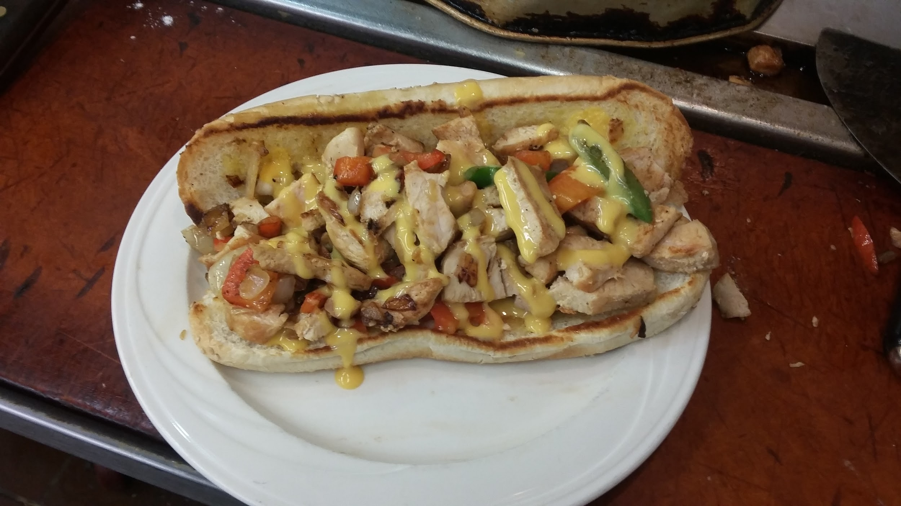
Goal
I did accomplish my goal
Goal: Cook and Prepare 5 different dishes
Anything to enhance the experience: A more extensive menu to cook off of

Slide 10
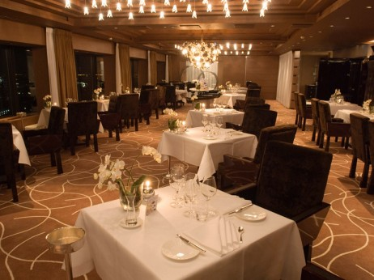
The Next Step
If the choice was given I would want to be placed at a high end fancy restaurant with moderate business
Lots of knowledge and passion to take in from a single place

Slide 11
Citations
http://www.advancedmechanicalplus.com/wp-content/uploads/2014/09/Slider-1.jpg
http://media4.s-nbcnews.com/j/msnbc/Components/Photo_StoryLevel/080325/080325-gordon-ramsay-hmed-12p.grid-6x2.jpg
http://www.bls.gov/OCO/
http://img.foodnetwork.com/FOOD/2009/06/22/FNM080109_GuysBigBite072_s4x3_lg.jpg
http://www.easyice.com/wp-content/uploads/2014/11/SuperCleanKitchen.jpeg
https://d3ui957tjb5bqd.cloudfront.net/images/screenshots/products/22/228/228908/d8y1ucsf8z2b3k4vcqrq5id0rr9p0i00ehhqent2jwtqsxuwforyfm3ikkd5dznl-f.jpg?1415208277
http://www.bsaarchitects.com/sites/default/files/SRJC-CAC_Classroom(c)Wakely.jpg
http://theculinarycook.com/wp-content/uploads/2015/02/cooking-multitask.jpg
http://vpninfotech.com/wp-content/uploads/2016/01/individuals_groups.jpg
http://previews.123rf.com/images/francesco83/francesco831204/francesco83120400055/13214674-collage-of-various-photo-of-delicious-italian-pasta-dishes--Stock-Photo.jpg
http://www.elitetraveler.com/wp-content/uploads/2012/12/CIEL-BLEU-462x346.jpg
https://c1.staticflickr.com/3/2615/4229577477_71216a43d2_b.jpg

